Slide 1
JDBC in JAVA
Presented By-
Krati Tamrakar

Slide 2
Outlines :-
Introduction to JDBC
JDBC Architecture and its components
Types of JDBC Architecture
JDBC Drivers and its types
Steps to connect with database
Prepared Statement
Callable statement

Slide 3
JDBC
JDBC stands for Java Database Connectivity is a Java API(Application Programming Interface) used to interact with databases.
JDBC receives queries from Java Application program and communicate with Database.
We can use JDBC to execute queries on various databases and perform operations like SELECT, INSERT, UPDATE and DELETE.
Basically the main purpose of JDBC is to connect java with database.
JDBC is highly recommended for Java applications as there are no platform dependency problems.

Slide 4
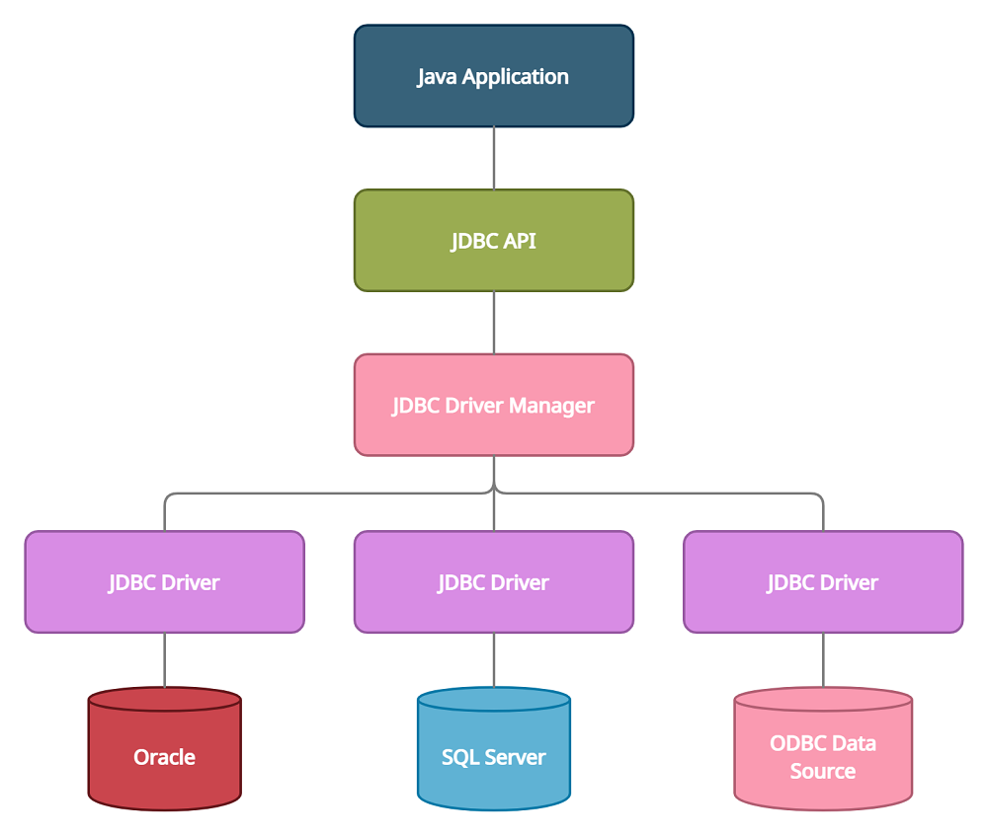
Architecture of JDBC
JDBC has four main components that are used to connect with a database as follows:
JDBC API
JDBC Driver Manager
JDBC Drivers
Data Sources

Slide 5
Components of JDBC
JDBC API
The JDBC API is an Application Programming Interface used to create Databases. JDBC API uses classes and interfaces to connect with databases.
Some of the important classes and interfaces defined in JDBC architecture in java are the DriverManager class, Connection Interface, etc.
DriverManager
DriverManager class in the JDBC architecture is used to establish a connection between Java applications and databases.
Using the getConnection method of this class a connection is established between the Java application and data sources.

Slide 6
JDBC Drivers
JDBC drivers are used to connecting with data sources. All databases like Oracle, MSSQL, MYSQL, etc. have their drivers, to connect with these databases we need to load their specific drivers.
Class is a java class used to load drivers.
Class.forName() method is used to load drivers in JDBC architecture.
Data Sources
Data Sources in the JDBC architecture are the databases that we can connect using this API. These are the sources where data is stored and used by Java applications. JDBC API helps to connect various databases like Oracle, MYSQL, MSSQL, PostgreSQL, etc.

Slide 7
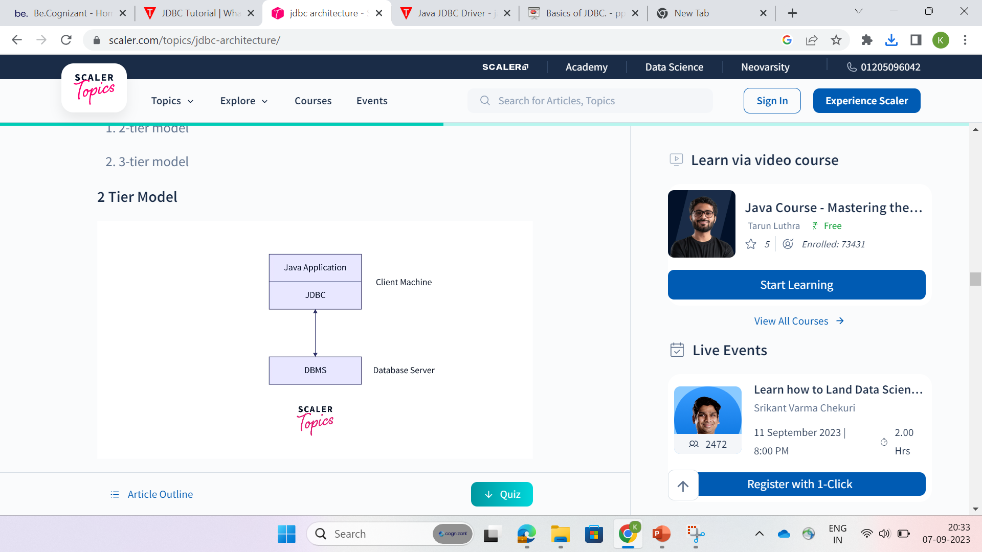
Types of JDBC Architecture :-
2-tier Architecture
2-tier JDBC architecture model is a basic model.
In this model, JDBC driver is used to establish a connection between the application and the data source.
When an application needs to interact with a database, a query is directly executed on the data source and the output of the queries is sent back to the user in form of results.
In this model, the data source can be located on a different machine connected to the same network the user is connected to.
This model is also known as a client/server configuration. Here user's machine acts as a client and the machine on which the database is located acts as a server.

Slide 8
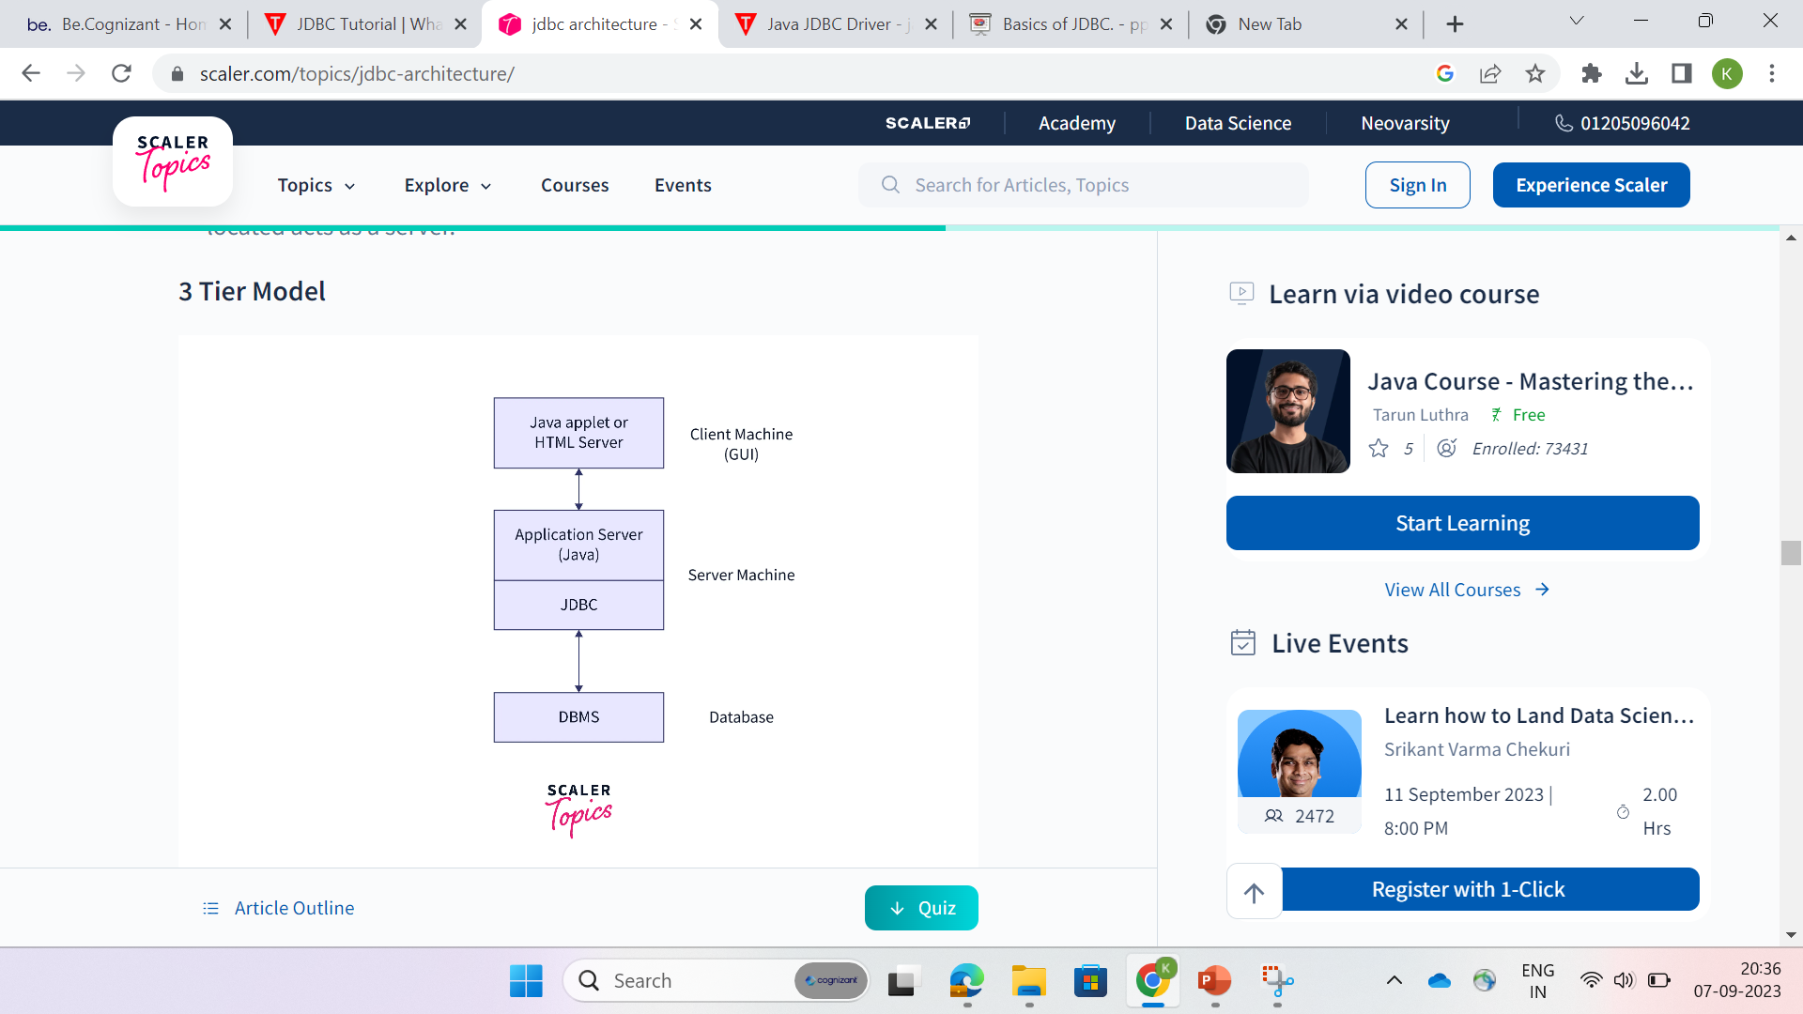
3-tier Architecture
3-tier model is a complex and more secure model of JDBC architecture in java.
In this model the user queries are sent to the middle tier and then they are executed on the data source.
Here, the java application is considered as one tier connected to the data source(3rd tier) using middle-tier services.
In this model user queries are sent to the data source using middle-tier services, from where the commands are again sent to databases for execution.
The results obtained on the database are again sent to the middle-tier and then to the user/application.

Slide 9
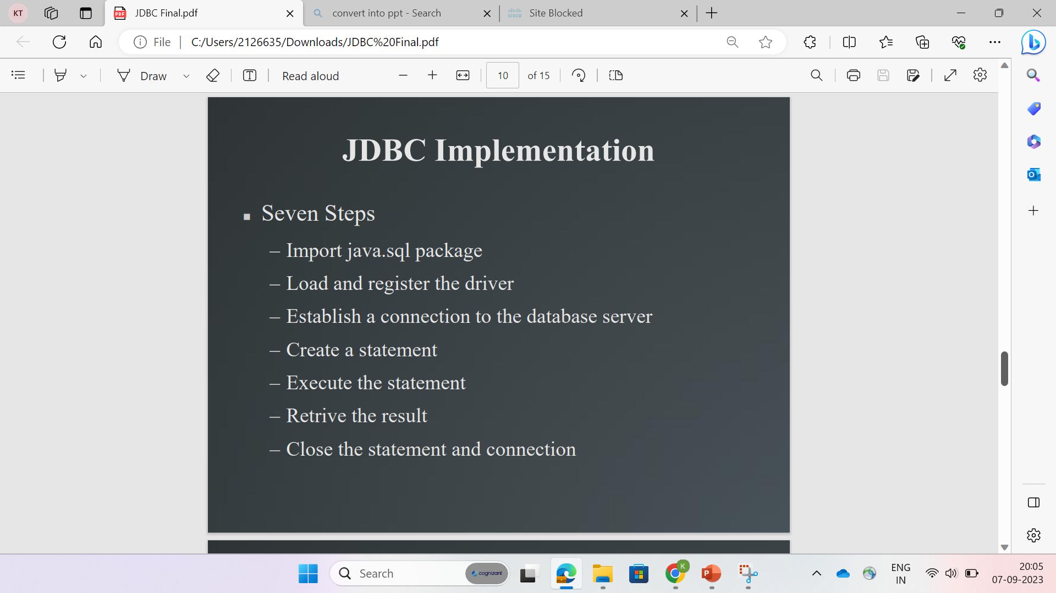

Slide 10
Working of JDBC
Load Driver: Load JDBC Driver for specific databases using forName() method of class Class.
Syntax: Class.forName("com.mysql.jdbc.Driver")
2. Create Connection: Create a connection with a database using DriverManager class. Database credentials are to be passed while establishing the connection.
Syntax: Connection conn=DriverManager.getConnection("URL“,”Username”,”password”);
3. Create Query: To manipulate the database we need to create a query using commands like INSERT, UPDATE, DELETE, etc. These queries are created and stored in string format.
Syntax: String sql_query = "INSERT INTO Student(name, roll_no) values('ABC','XYZ’)”

Slide 11
4. Create Statement: The query we have created is in form of a string. To perform the operations in the string on a database we need to fire that query on the database. To achieve this we need to convert a string object into SQL statements.
This can be done using createStatement() and prepareStatement() interfaces.
Syntax: Statement St =con.createStatement();
5. Execute Statement: To execute SQL statements on the database we can use two methods depending on which type of query we are executing.
Execute Update: Execute update method is used to execute queries like insert, update, delete, etc. Return type of executeUpdate() method is int.
Syntax: int check = st.executeUpdate(sql);
Execute Query: Execute query method is used to execute queries used to display data from the database, such as select. Return type of executeQuery() method is result set.
Syntax: Resultset = st.executeUpdate(sql);

Slide 12
boolean execute(String SQL): Returns a boolean value of true if a ResultSet object can be retrieved; otherwise, it returns false. Use this method to execute SQL DDL statements or when you need to use truly dynamic SQL.
Syntax:
boolean ResultSet = stmt.execute(sql);
6. Closing Statement: After performing operations on the database, it is better to close every interface object to avoid further conflicts.
Syntax: con.close();

Slide 13
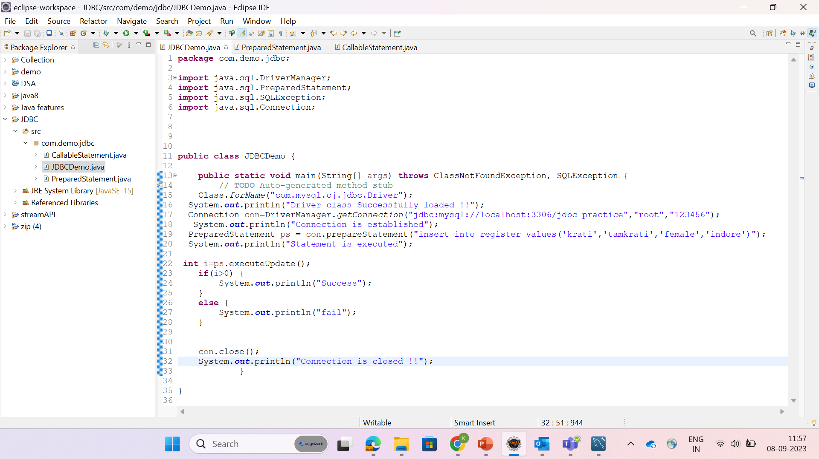

Slide 14
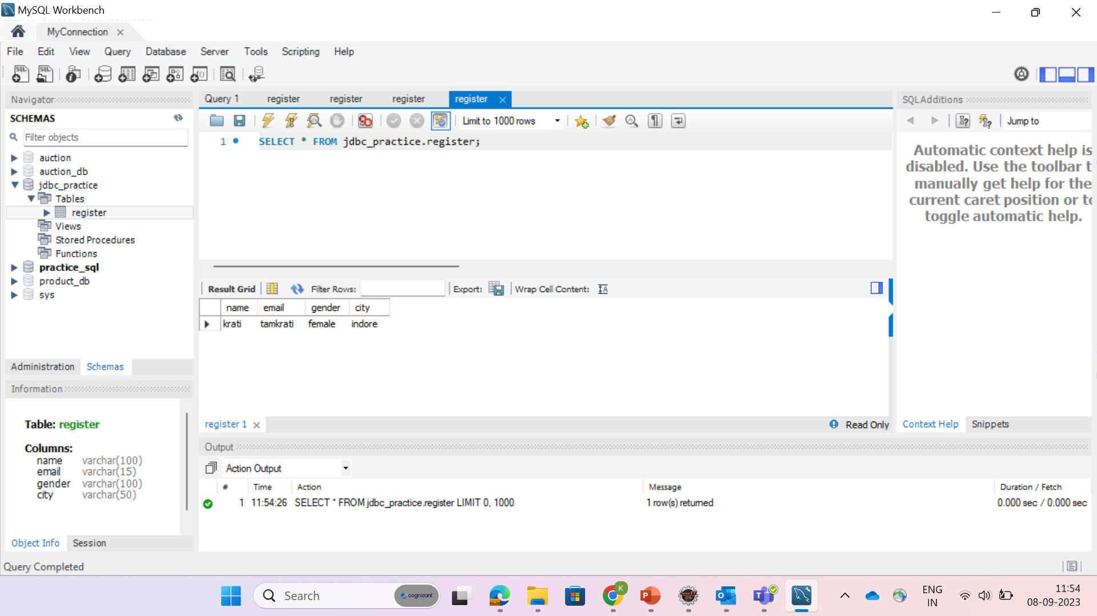

Slide 15
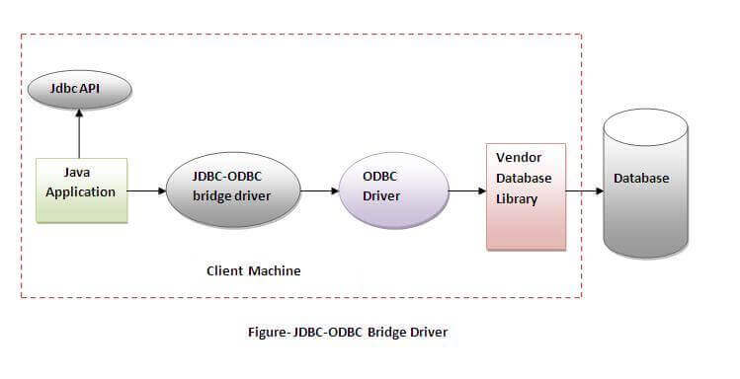


Slide 16
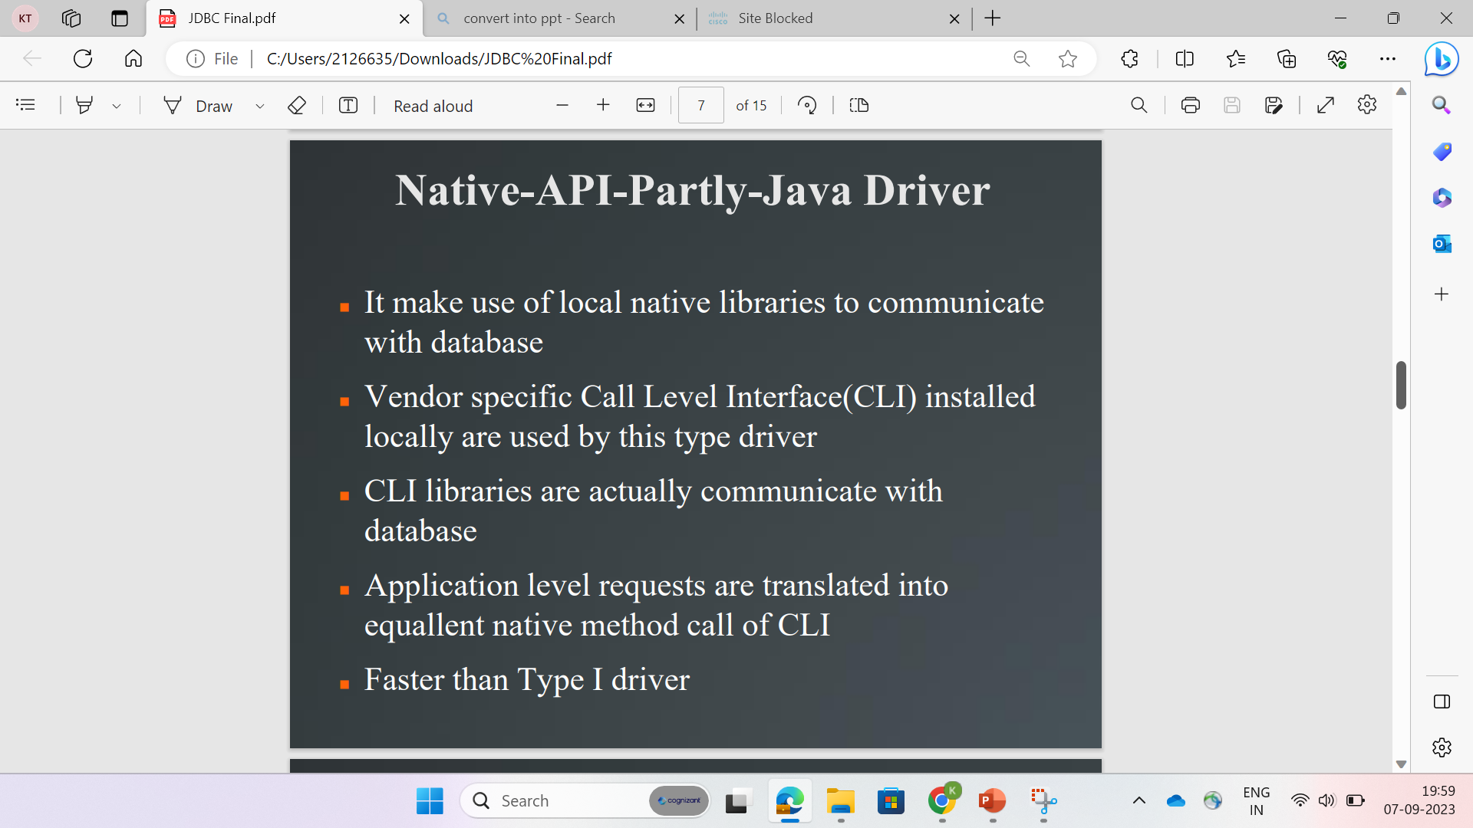
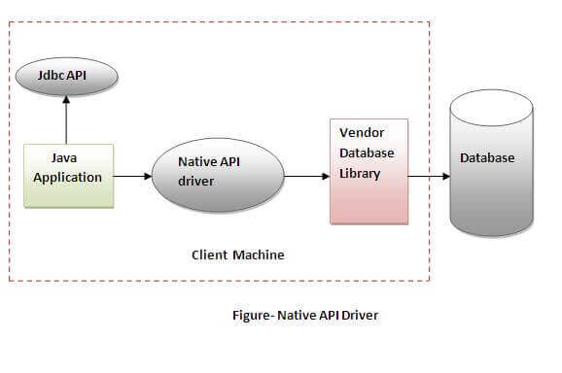

Slide 17
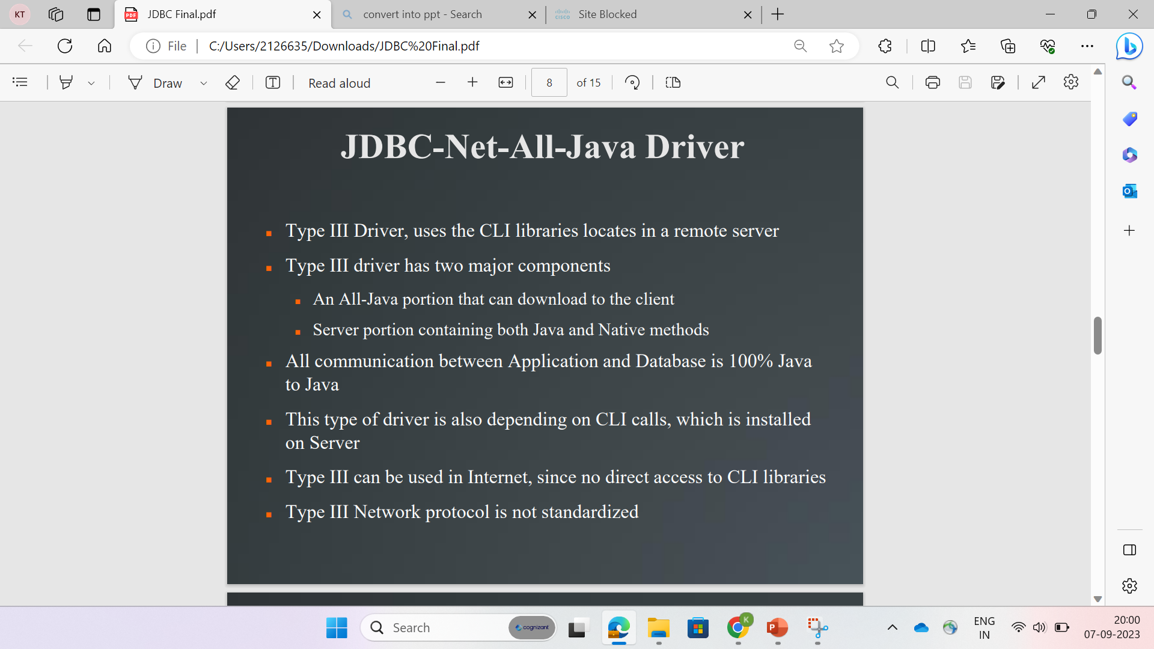
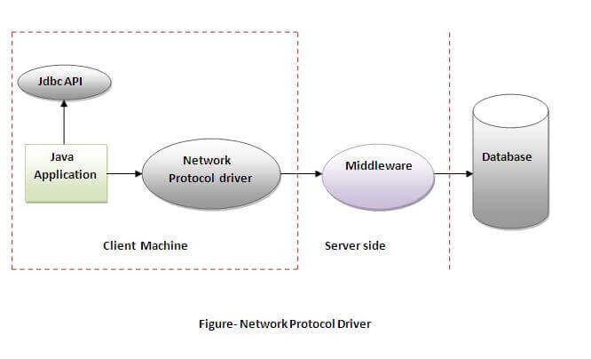

Slide 18
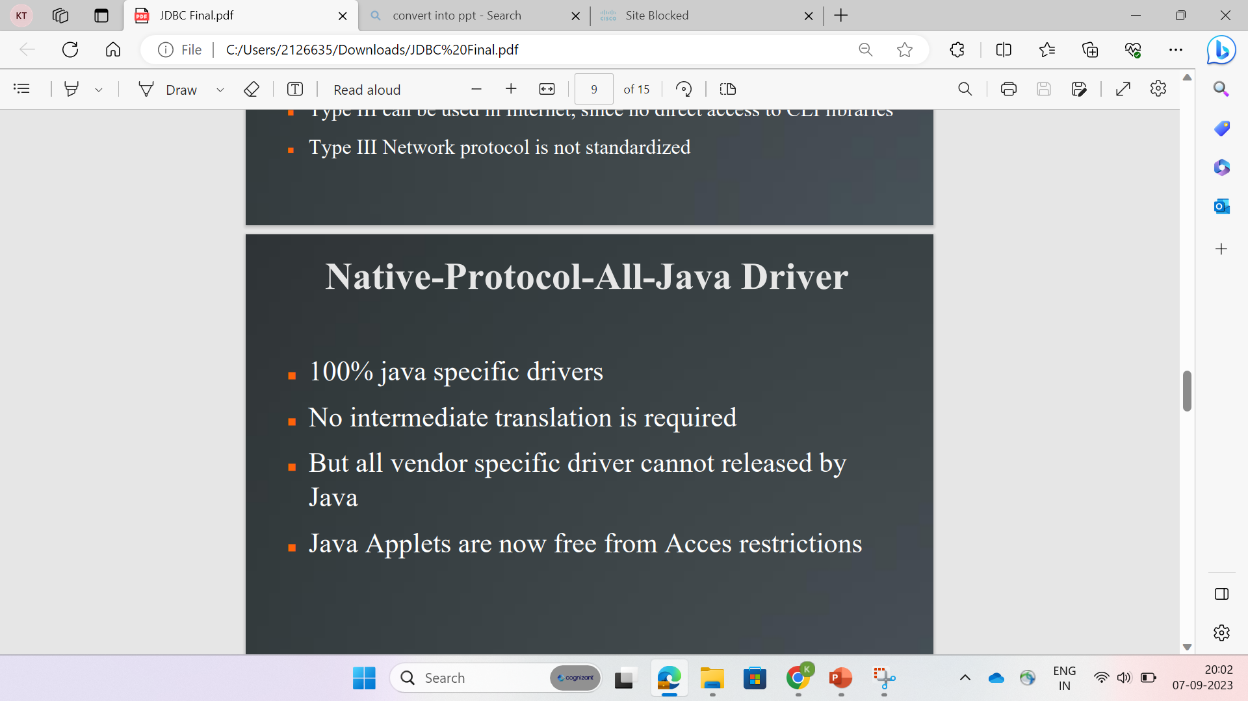
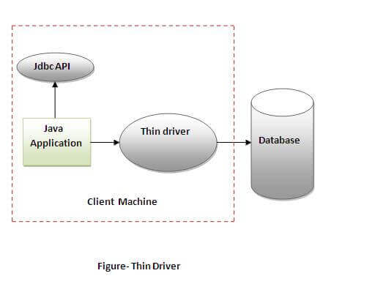

Slide 19
PreparedStatement interface –
The PreparedStatement interface is a subinterface of Statement which is used to execute parameterized query.
The performance of the application will be faster if you use PreparedStatement interface because query is compiled only once.
The prepareStatement() method of Connection interface is used to return the object of PreparedStatement.
Syntax- PreparedStatement stmt=con.prepareStatement("insert into Emp values(?,?)");
we are passing parameter (?) for the values. Its value will be set by calling the setter methods of PreparedStatement.
stm.setInt(1,101);
stm.setFloat(2,32.8);
stm.setString(3,"Ratan");

Slide 20
CallableStatement interface –
CallableStatement interface is used to call the stored procedures and functions.
The prepareCall() method of Connection interface returns the instance of CallableStatement.
The sql_string will be passed as an argument to the prepareCall() method.
Syntax- CallableStatement cs = con.prepareCall(sql_string);
This method accepts a string variable representing a query to call the stored procedure and returns a CallableStatement object.
It can have input parameters, output parameters or both.

Slide 21


